Slide 1
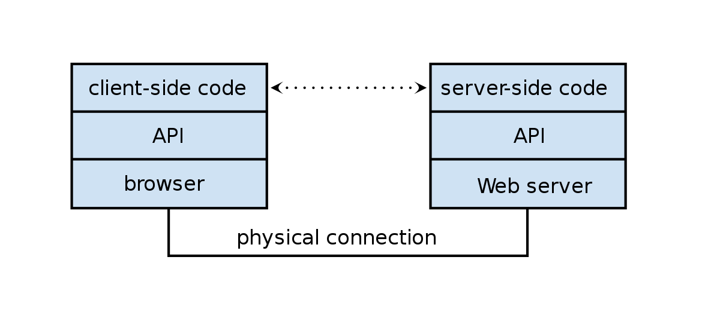
Express, Middleware & Routing
Frank Walsh

Slide 2
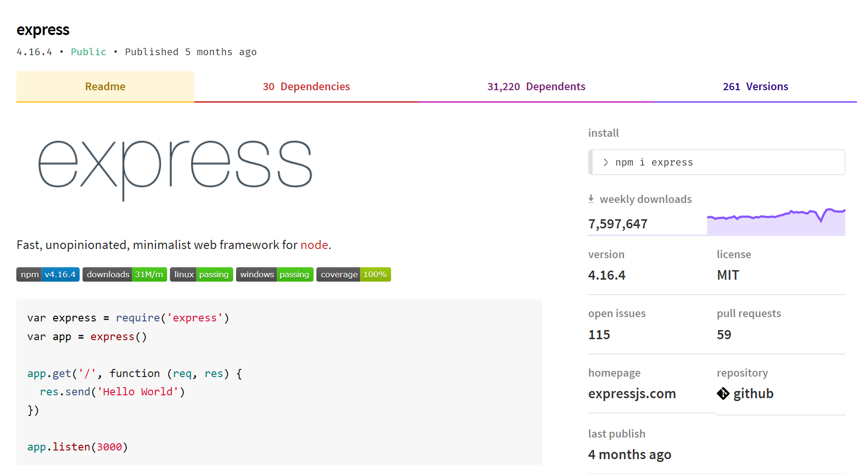
What is Express?
Notes:
Web application framework for Node
Built on the Connect middleware package
It's popular because it‘s
Minimalist,
Fast
Simple

Slide 3
What Express Gives Us...
Parses arguments and headers
Easy Routing
Route a URL to a callback function
Sessions
File Uploads
Middleware…

Slide 4
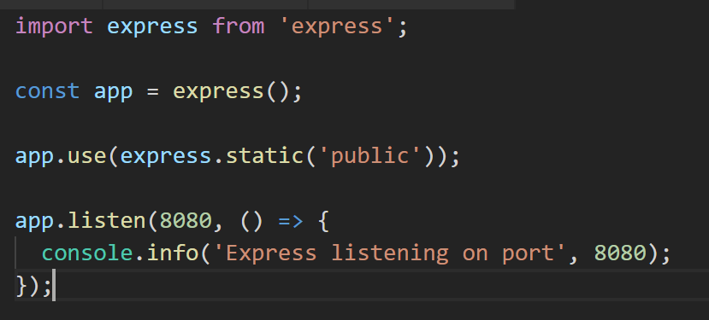
Simple Express App (index.js)
Loads Express module
Instantiates Express server
Define static content for HTTP GET

Slide 5
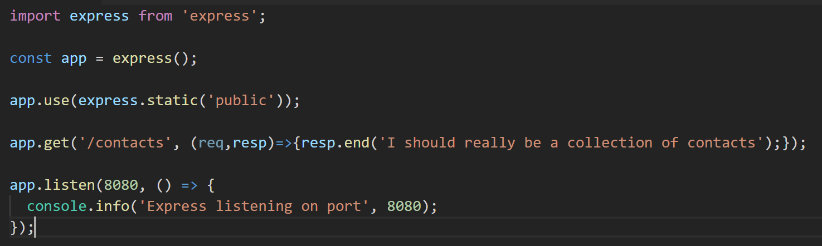
(/*)?
Routing Examples
Syntax follows the pattern:
App.[verb](path, (req,res)=>{});
HTTP POST request
// Other Route examples
app.post(‘/contacts’, createContact);
app.get(‘/contacts/:id’, contactsRouter);
//Catch-all
app.all(‘/private(/*)?', requiresLogin);
Parametised URL. Accepts :app route argument
Catch-all – works for all HTTP verbs
Notes:
DEMO!

Slide 6
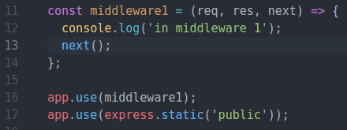
Express Middleware
Express is a Routing and Middleware framework.
Middleware functions have access to the Request,Response and the next() function
The next function calls the next middleware function.
Use middleware to
Change the request/response
End the request/response cycle
Call the next middleware in the stack.
If middleware does not call next() or return, express will just hang
Can be an issue with promises but can be resolved

Slide 7
Express Middleware stack
The HTTP request (also the response) passes through a pipeline/stack of middleware functions
Some task is executed at each stage:
Express App
HTTP Request
Authenticate
Parse Body
Main Task
http response
Notes:
check request is authenticated,
parse body
“inject” as an extra param in the request

Slide 8
Express Middleware
Middleware functions have access to the request object (req), the response object (res), and the next middleware function in an express application’s request-response cycle.
Your express app will have a ‘stack’ of middleware functions that can
Execute any code.
Make changes to the request and the response objects.
End the request-response cycle.
Call the next middleware function in the stack.
Notes:
DEMO!

Slide 9

Express Middleware Types
3rd Party (e.g. dotenv)
Router level
App level (app.use(…))
Every request is handled
Error handlers
Takes error as first parameter (err,req,res,next) => { …. }
Baked in
Express.static()

Slide 10

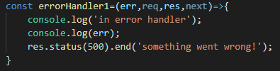
Middleware Functions
App level, 3rd party receive 3 arguments
Error Handling middleware receive 4 arguments(error first)

Slide 11
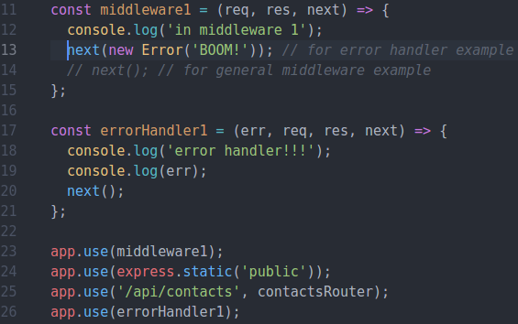
Express Middleware – Error Middleware
Raise error and pass on to next error handling middleware in middleware stack
NOTE: Middleware stack processed in the order it appears in script.
Notes:
DEMO!

Slide 12
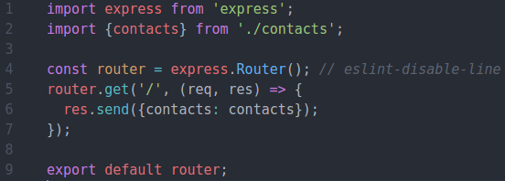
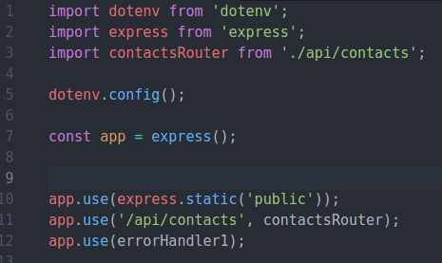
Express Routers
/api/contacts/index.js (contacts router)
Exports router instance
Can have several "routers" to implement your APIs.
Router can have its own routing and middleware
Good for multiple APIs/ versioning
Still uses the application level middleware of express app.
/index.js (express app)
Mount router to URL.
/api/contacts becomes Base Route for router
Notes:
DEMO! Use the express.Router class to create modular, mountable route handlers. A Router instance is a complete middleware and routing system; for this reason, it is often referred to as a “mini-app”.

Slide 13
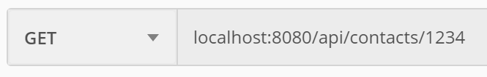
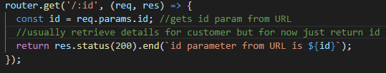

Express Routers – Parameters
Route parameters are named URL segments that capture the values specified at their position in the URL.
The req.params object contains the parameter values, with the name of the route parameter specified in the path as their respective keys.
Notes:
DEMO

Slide 14

Express Request Object
The req object represents the HTTP request.
by convention, the object is referred to as 'req', Response is 'res'
Can use it to access the request query string, parameters, body, HTTP headers.
Example:
Parameterised URL. Access using req.params.id
Notes:
Req.Param is an abstraction layer for picking up information about a request – it automatically searches:
Query strings
Posted form values
Route values
And will let you pick from what’s available
14

Slide 15
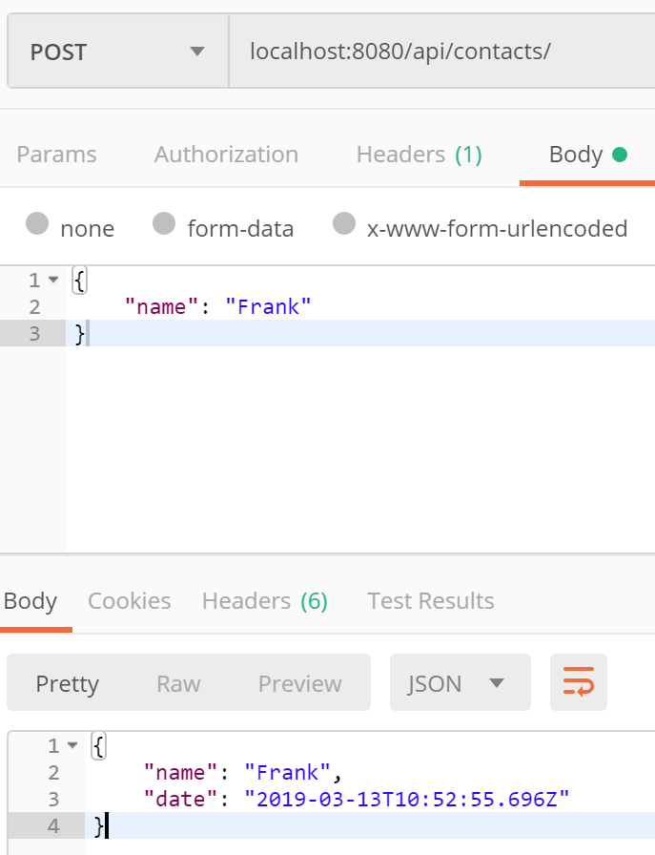

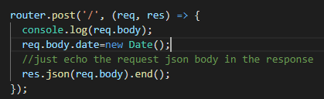
Express Request Object
req.body
Contains data submitted in the request body. ​​
Need express json parsing middleware.
index.js code snip (express app)
Testing using Postman
/api/contacts/index.js code snip (contactsRouter)

Slide 16
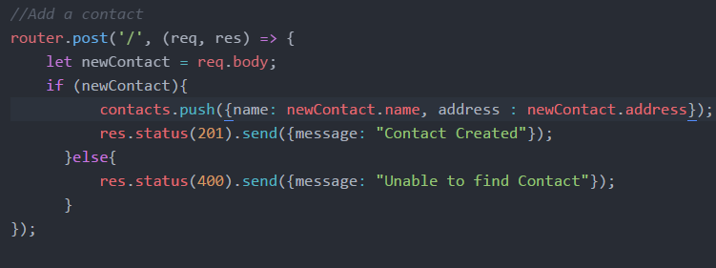
Express Response Object
The res object represents the HTTP response that an Express app sends when it gets an HTTP request.

Slide 17

Express Response Properties
res.send([body])
The body parameter can be a String, an object, or an Array.
For example:

Slide 18
Response Properties
res.json([body])
actually calls res.send(), but before that it:
ensures the response will have utf8 charset and application/json content-type res.json({ user: 'tobi' })
res.status(500).json({ error: 'message' })

Slide 19
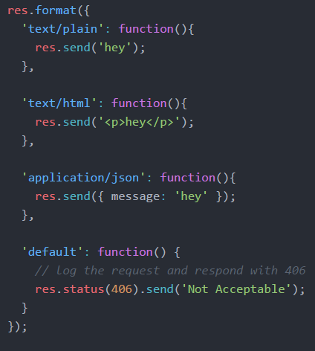
Response Properties
res.format(object)
Performs content-negotiation on the Accept HTTP header on the request object
Addresses "multiple representations" REST principle

Slide 20
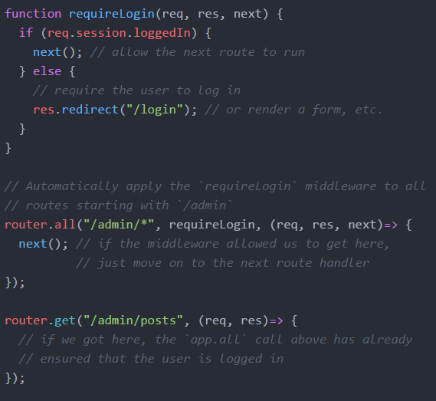
Filters
If you want to authenticate for access to resources you can use multiple callbacks built into express routing.
Multiple Callbacks

